Slide 1


The #1 software development tool used by agile teams
Presenters:
Ngô Công An
Đào Xuân Thủy

Slide 2


L
OREM IPSUM
A
aBb
C
c
Software Development
ax
2
+
b
x + c = 0
ax
2
+
b
x + c
x
2
y

Slide 3
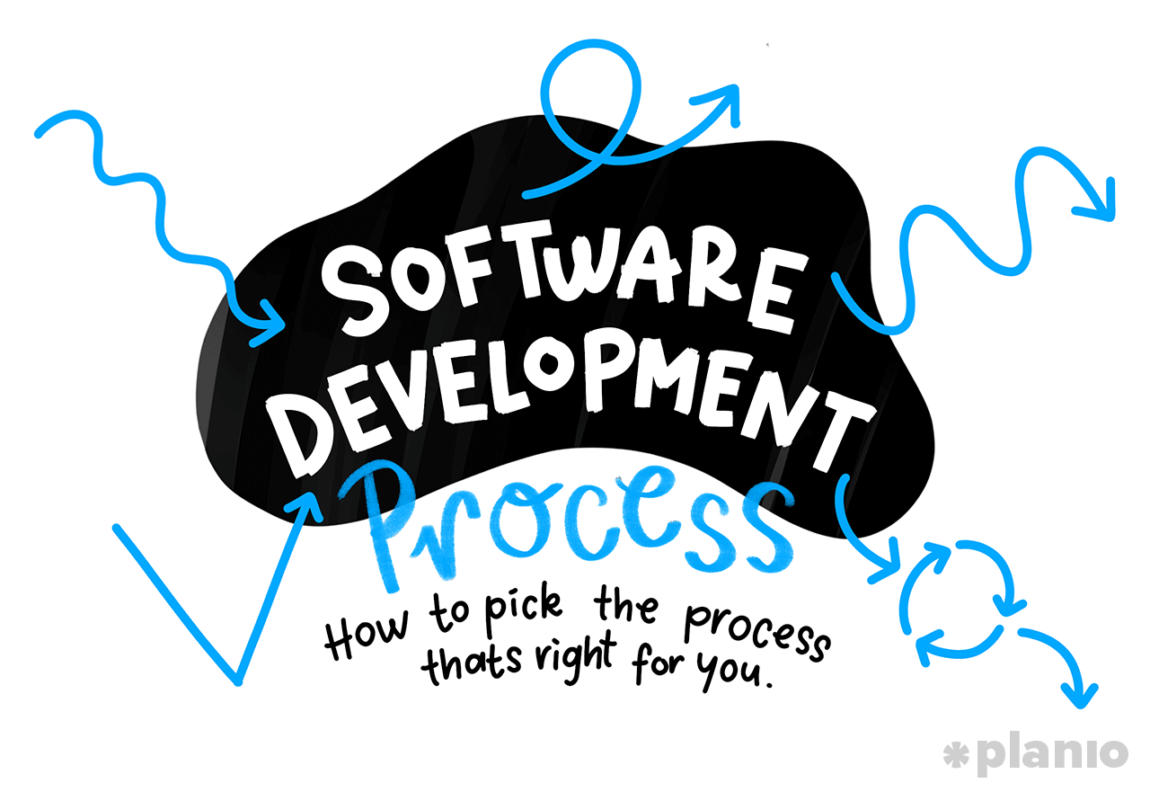
Work together ?
?
?
?

Slide 4






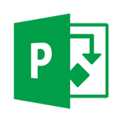

Project management software
CA Clarity
Trello
Basecamp
Asana
Podio
Microsoft Project

Slide 5


The best project management software
Launched in 2002
10m monthly active users
150k Atlassian customers
In over 190 countries

Slide 6
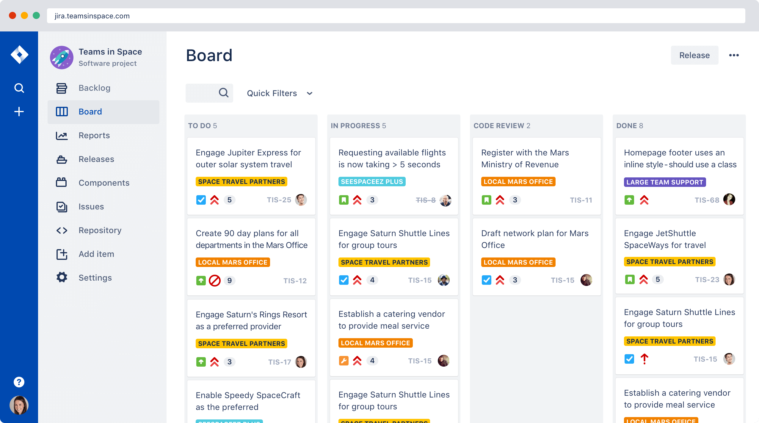
Plan
Create user stories and issues,
plan sprints, and distribute
tasks across your software team.
Track
Prioritize and discuss your
team’s work in full context
with complete visibility.
Notes:
Tạo vấn đề, phổ biến tới team
Mức độ ưu tiên giữa các công việc, discuss, comment đẩu đủ các phương tiện

Slide 7
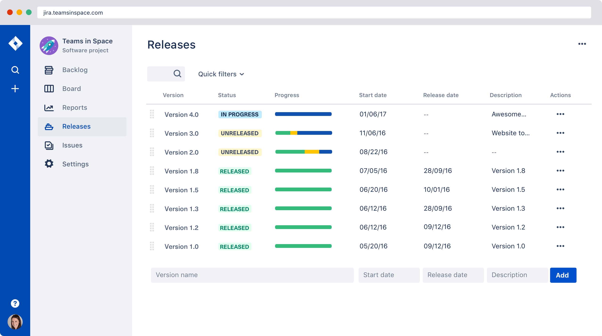
Release
Ship with confidence and
sanity knowing the information
you have is always up-to-date.
Report
Improve team performance based on real-time, visual data that your team can put to use.
Notes:
Tạo vấn đề, phổ biến tới team
Mức độ ưu tiên giữa các công việc, discuss, comment đẩu đủ các phương tiện

Slide 8
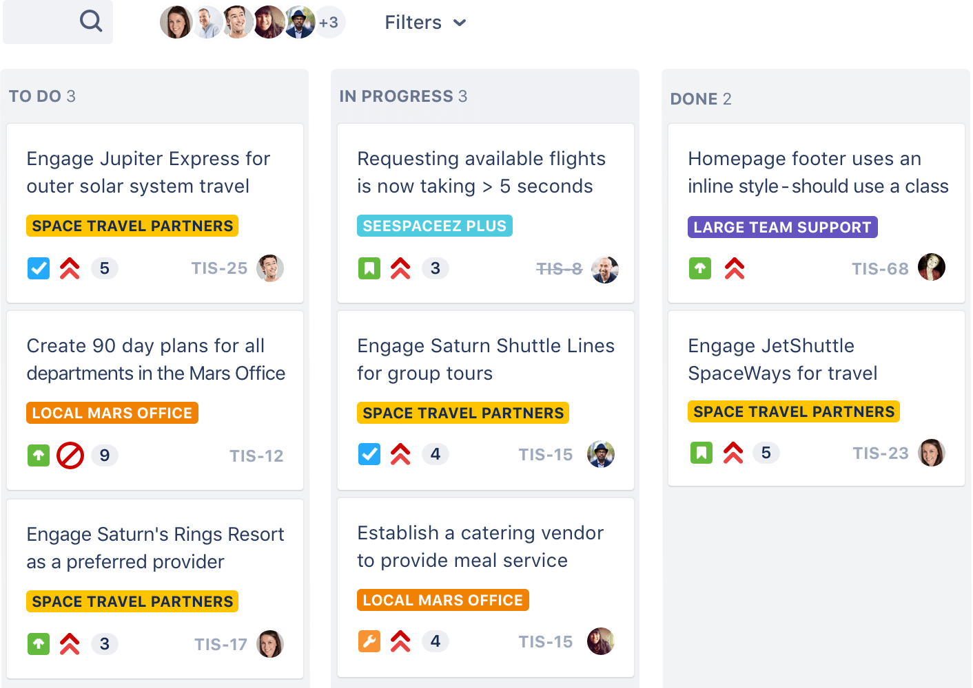
Scrum boards
Agile teams can stay focused on delivering iterative and incremental value, as fast as possible, with customizable scrum boards.

Slide 9
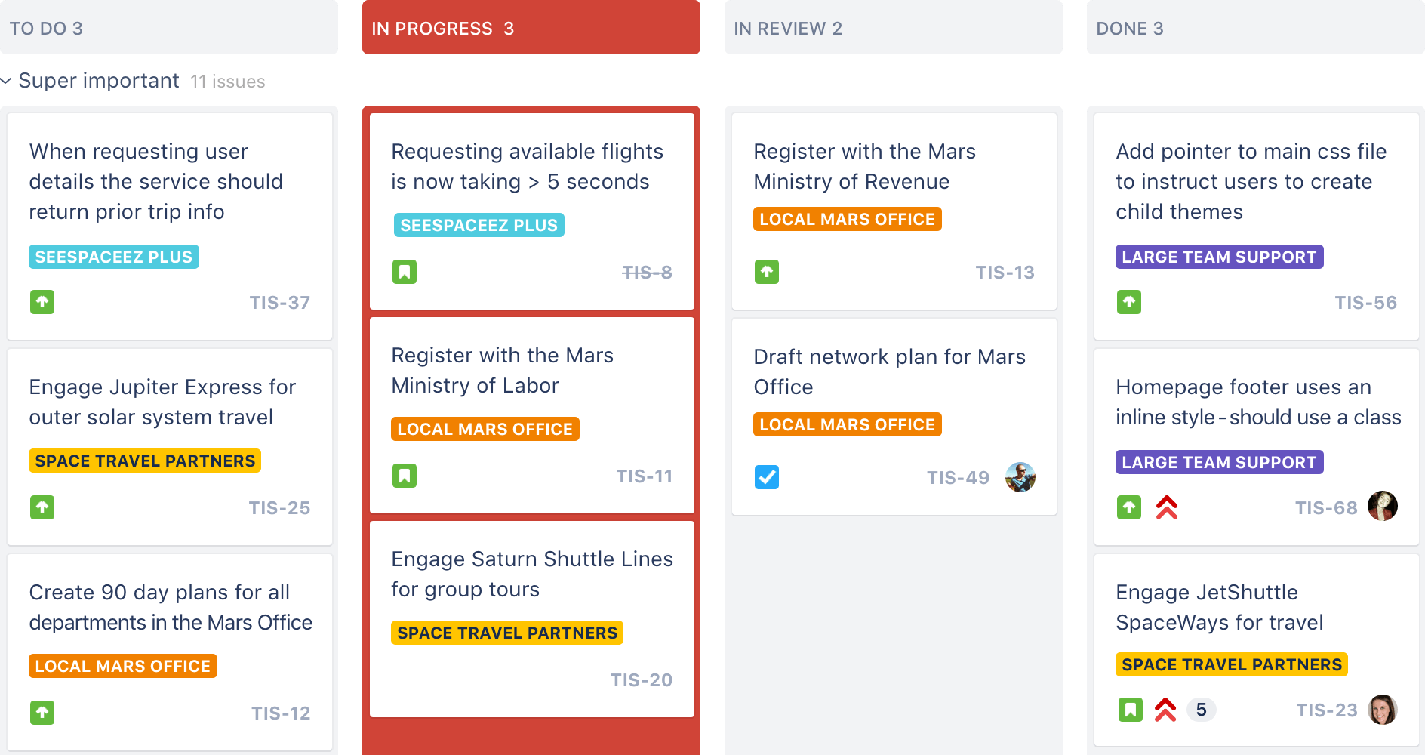
Kanban boards
Flexible kanban boards give your team full visibility into what’s next so you can continuously deliver maximum output in minimal cycle time.

Slide 10
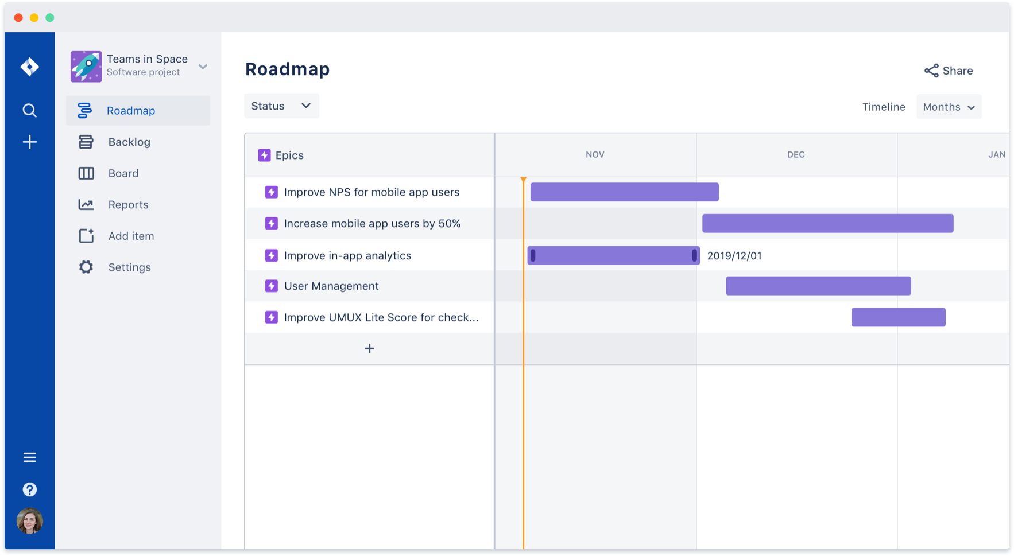
Roadmaps
Sketch out the big picture, communicate plans with stakeholders, and ensure your roadmap connects to your team's work - all in a few clicks in Jira Software Cloud.

Slide 11
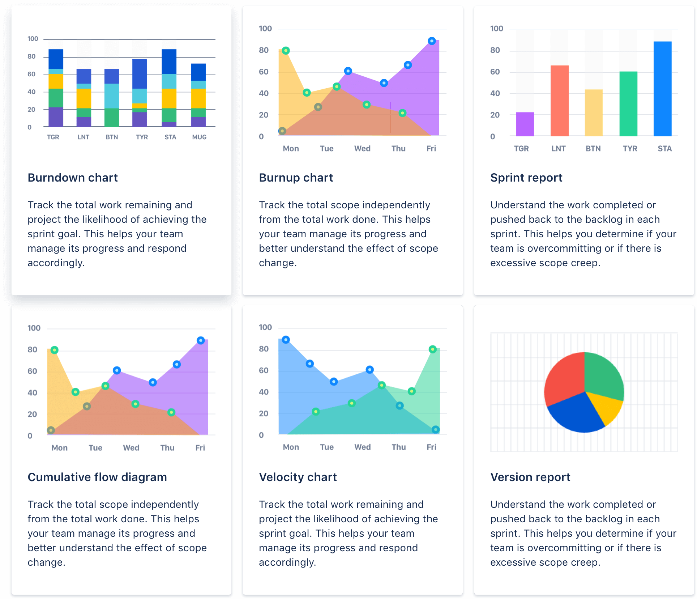
Agile reporting
Teams have access to more than a dozen out-of-the-box reports with real-time, actionable insights into how their team is performing sprint over sprint.

Slide 12
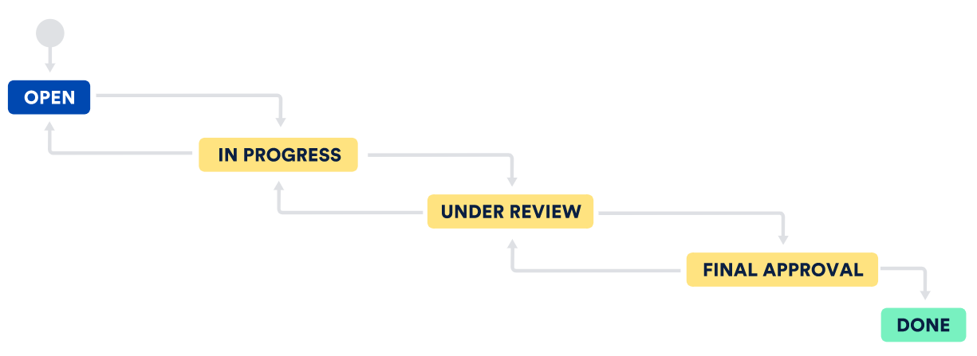
Choose a workflow, or make your own
Every team has a unique process for shipping
software. Use an out-of-the-box workflow, or
create one to match the way your team works.

Slide 13


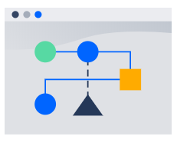
Integrate with the tools you already use
Upgrade your workflow with Confluence, Bitbucket, and hundreds of other developer tools.
Continuous integration and deployment
Knowledge management
Development workflow
Transform product requirements in Confluence into a Jira Software backlog with one click.
Jira Software automatically updates issues and transitions work when code is committed in Bitbucket.
Supercharge your CI/CD with Pipelines and monitor build status from within Jira Software.

Slide 14




Designed for security and scale
Gain peace of mind with enterprise-grade solutions tailor-made to secure and scale Jira Software across your entire organization.
Privacy
Data Encryption
Jira Software invested in GDPR and Privacy Shield to ensure all data is handled with care.
Jira Software leverages encryption in transit and at rest to safeguard your organization's data.
Continuous integration and deployment
Jira Software Premium
Verify Jira Software's security with SOC2, SOC3, ISO 27001, ISO 27018, PCI DSS, and more.
Ready to scale with 99.9% uptime SLAs, unlimited storage, 24/7 Premium Support, and more.

Slide 15
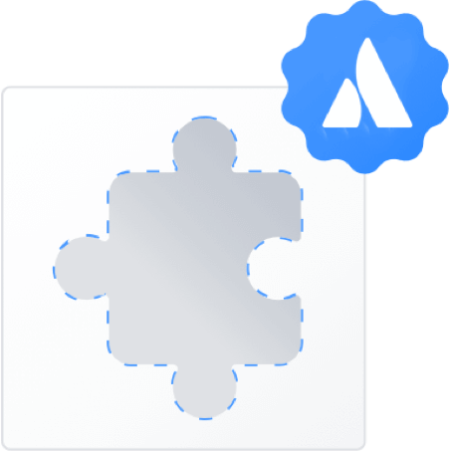
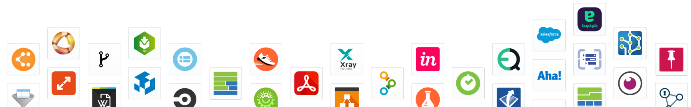
Extend Jira Software with apps
Portfolio for Jira, Tempo Timesheets, Zephyr, and over 3,000 other apps ensure Jira Software can be custom tailored to fit any and every use case.

Slide 16



Move work forward from anywhere
Track and manage projects in real time from the convenience of your favorite device with Jira mobile.

Slide 17

“Jira Software is instrumental in building and maintaining the best software on the market.”
DANIELE FARNEDI, TRULIA CTO
Trusted by over 65,000 customers worldwide

Slide 18
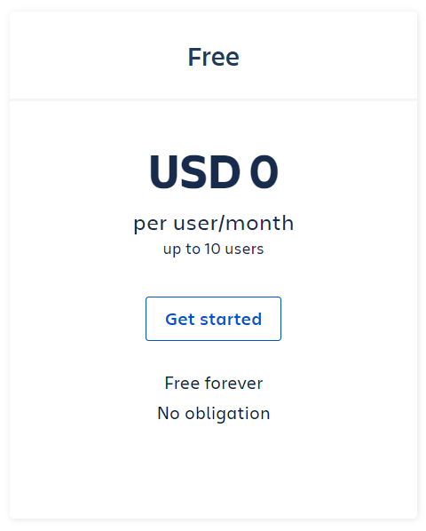
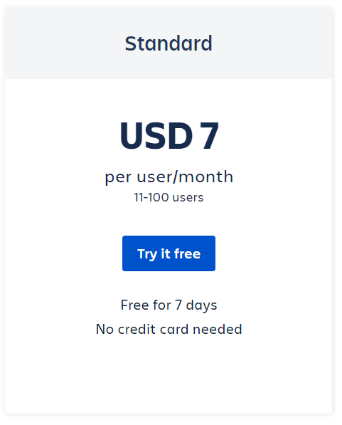
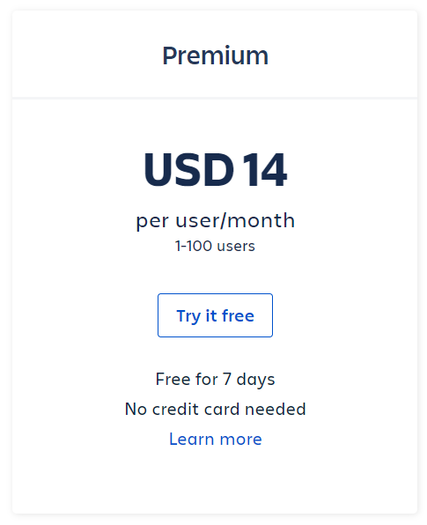
Simple plans hosted in the cloud

Slide 19
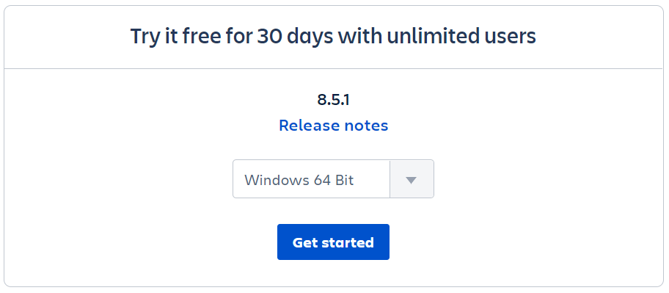
Download Jira Software Server
Host on your server for customization and control

Slide 20
Demo

